Slide 1
Electric-filed mapped averaging
For dielectric constant
Weisong Lin

Slide 2

Introduction
What is dielectric constant?
Definition from Wikipedia: The relative permittivity of a material is its dielectric permittivity expressed as a ratio relative to the permittivity of vacuum.
How to measure it?
+Q
+
+
+
+
+
+
+
+
+
+
+
+
+
+
d
-
-
-
-
-
-
-
-
-
-
-
-
-
-
-Q
Vacuum

Slide 3
Introduction
What is dielectric constant?
Definition from Wikipedia: The relative permittivity of a material is its dielectric permittivity expressed as a ratio relative to the permittivity of vacuum.
How to measure it?
+Q
+
+
+
+
+
+
+
+
+
+
+
+
+
+
d
-
-
-
-
-
-
-
-
-
-
-
-
-
-
-Q
Dielectric

Slide 4
Introduction
What is dielectric constant?
Definition from Wikipedia: The relative permittivity of a material is its dielectric permittivity expressed as a ratio relative to the permittivity of vacuum.
How to measure it?
+Q
+
+
+
+
+
+
+
+
+
+
+
+
+
+
-
-
-
-
-
-
-
+
+
+
+
+
+
+
-
-
-
-
-
-
-
-
-
-
-
-
-
-
-Q
Dielectric

Slide 5

Formalism
Free-energy perturbation
Find free energy difference by averaging over microstates sampled from ensemble
FEP:
0
1
0
1
Targeted FEP:
0
0`
1

Slide 6
Formalism
Mapped average
Mapped average improves the Target FEP by coupling to displacement of coordinates.
FEP:
Mapped average:
Introduce mapping :
0
0`
1

Slide 7
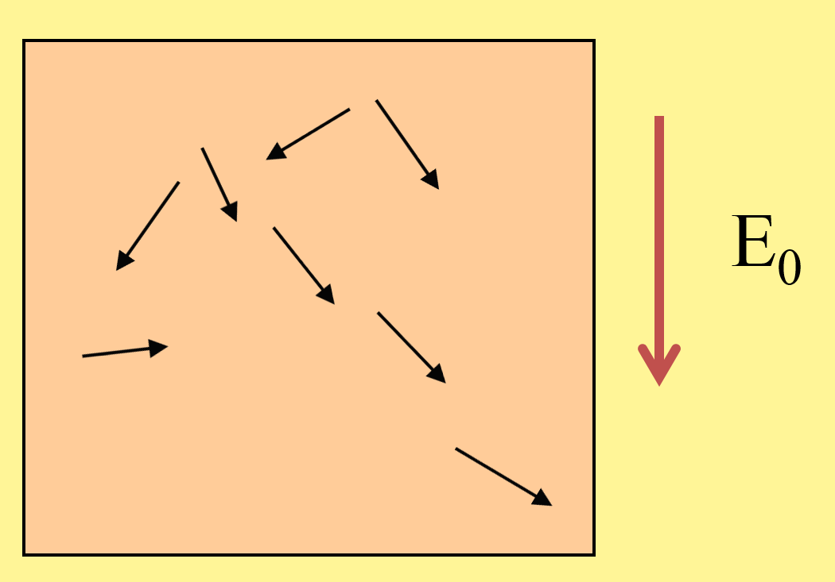
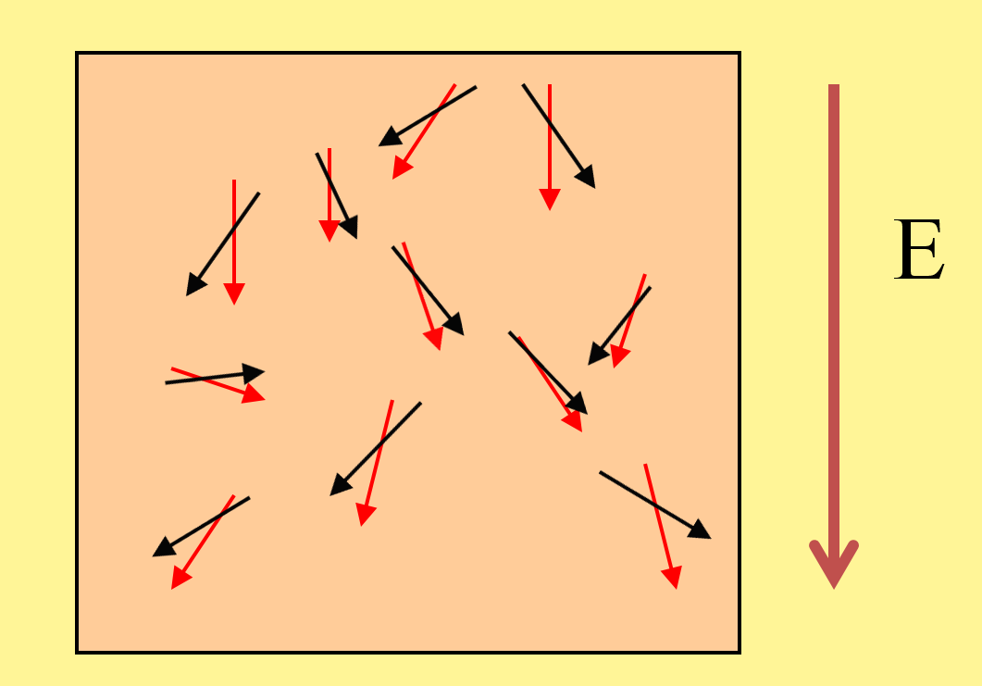
Formalism
Application to dielectric constant
Dielectric constant
0
Mapped averaging

Slide 8
Formalism
Application to dielectric constant
Mapping satisfies
With

Slide 9
Formalism
Necessary derivatives Re

Slide 10
Formalism
Necessary derivatives

Slide 11
Formalism

Slide 12

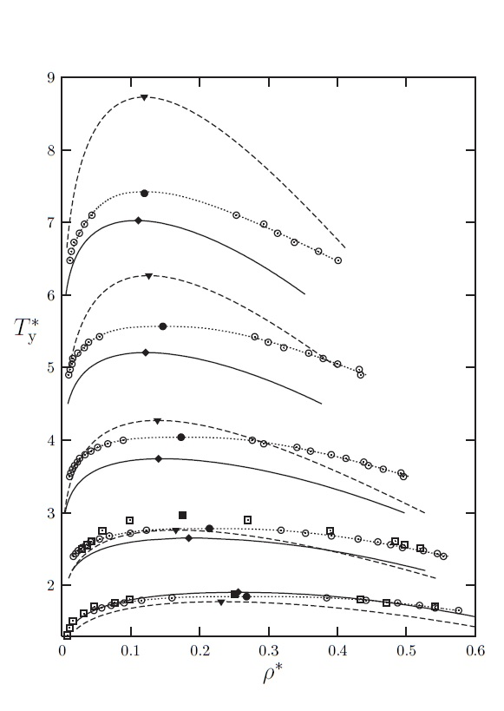
Results
StockMeyer Fluid phase diagram
Notes:
Liquid-vapour coexistence in the dipolar Yukawa hard-sphere fluid
Yu. V. Kalyuzhnyi1, I. A. Protsykevytch1, G. Ganzenmüller2 and P. J. Camp2
15 August 2008

Slide 13
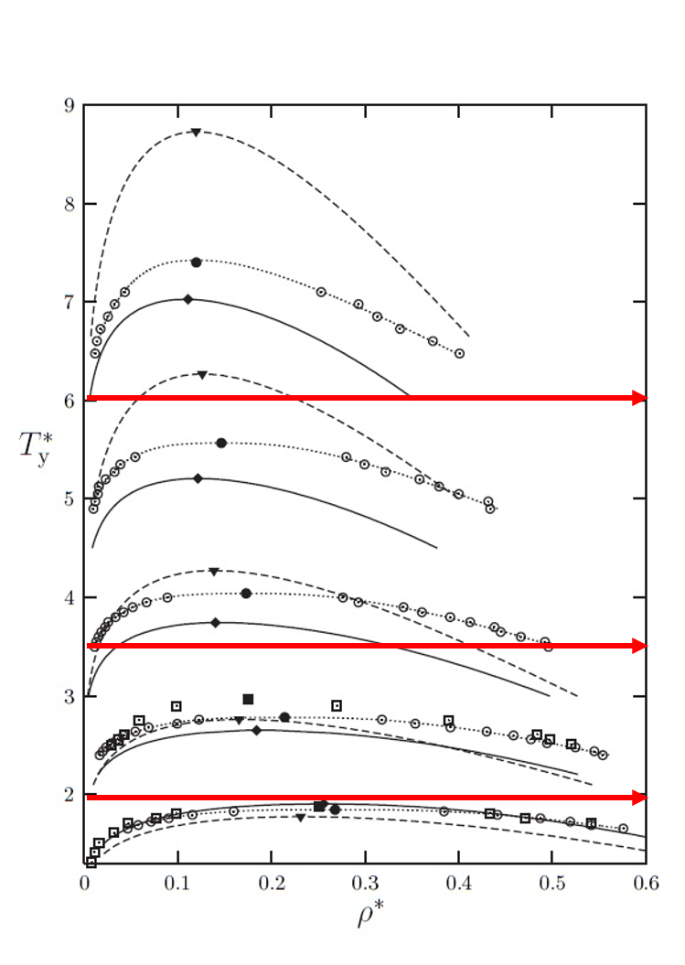
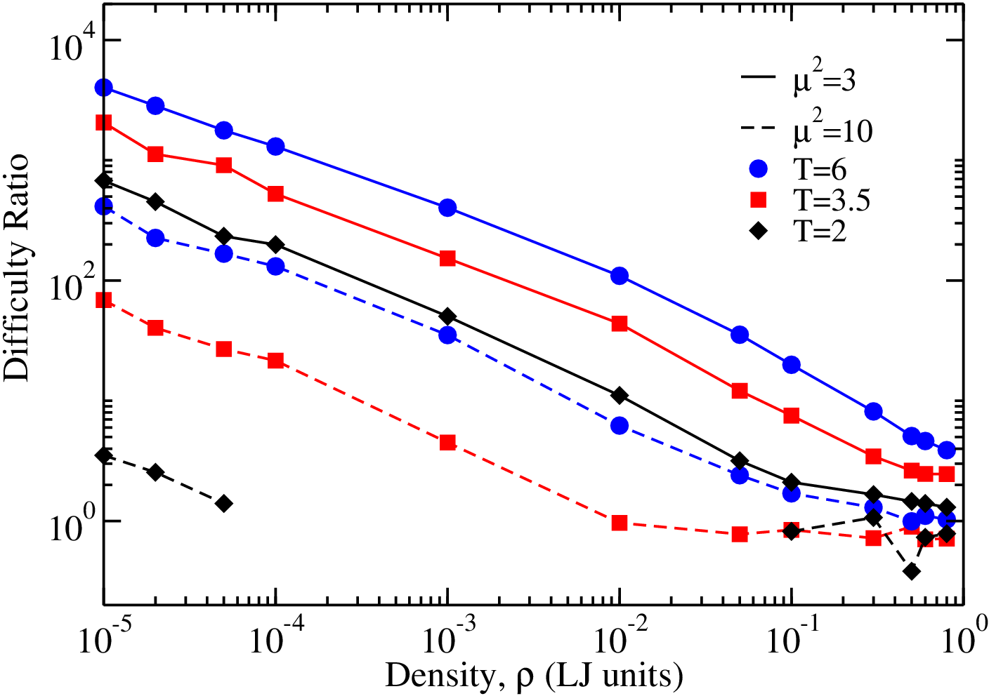
Results
Notes:
Results are presented in Fig. 3, where we plot the difficulty ratio for conventional versus mapped averaging, as a function of density for three temperatures and two values of the dipole strength D (note that \mu^2 for water). The performance improvement with mapped averaging is greatest at conditions where the noninteracting-dipole approximation to p is most appropriate: higher temperature, lower density, and smaller dipole strengths; the behavior correlates well with the dipolar coupling strength, 2=T .In the most favorable case presented (at very low density), the reduction of CPU is approaching a factor of 1108; the least-favorable case corresponds to a liquid-like density and temperature, where the advantage of mapped averaging (in this particular formulation, based on non-interacting dipoles) is negligible.

Slide 14
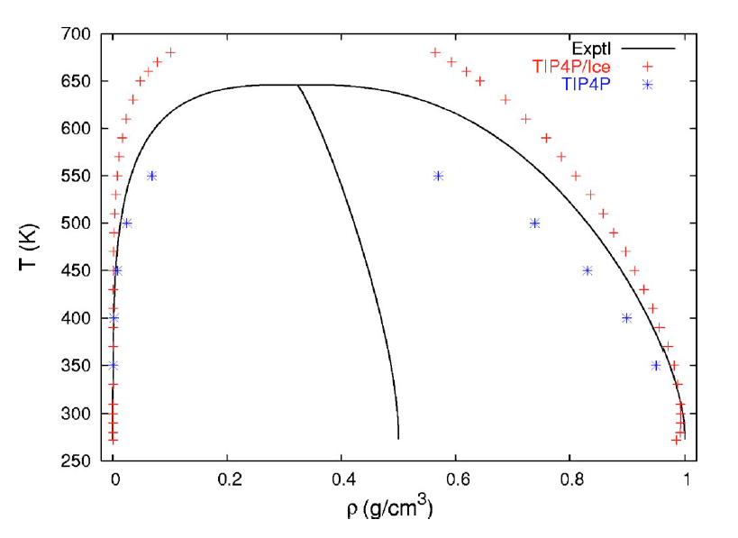
Results
Water phase diagram
Notes:
This picture form c Vapor-liquid equilibria from the triple point up to the critical point
for the new generation of TIP4P-like models: TIP4P/Ew, TIP4P/2005,
and TIP4P/ice
C. Vegaa and J. L. F. Abascal THE JOURNAL OF CHEMICAL PHYSICS 125, 034503 2006

Slide 15
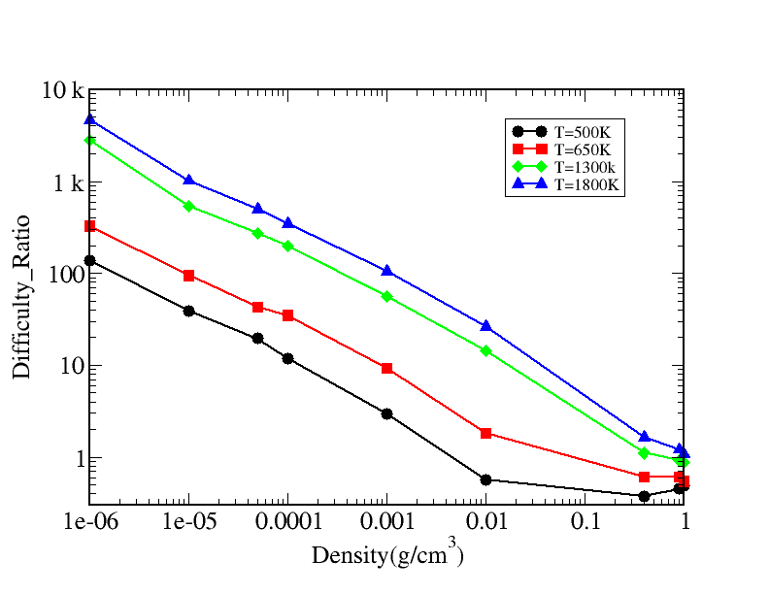
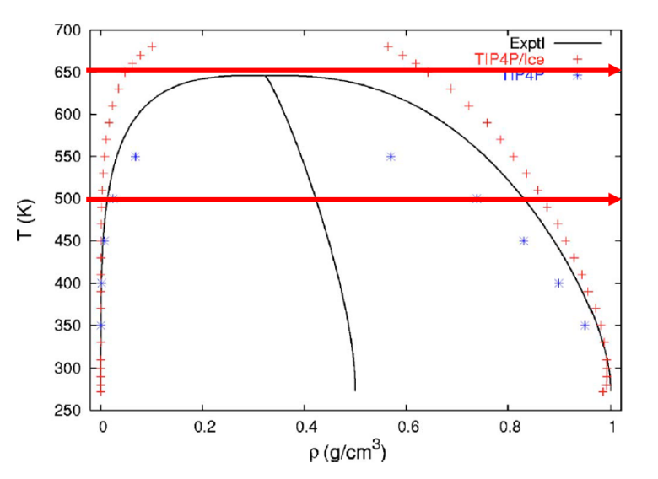
Result
Notes:
Results are presented in Fig. 3, where we plot the difficulty ratio for conventional versus mapped averaging, as a function of density for three temperatures and two values of the dipole strength D (note that \mu^2 for water). The performance improvement with mapped averaging is greatest at conditions where the noninteracting-dipole approximation to p is most appropriate: higher temperature, lower density, and smaller dipole strengths; the behavior correlates well with the dipolar coupling strength, 2=T .In the most favorable case presented (at very low density), the reduction of CPU is approaching a factor of 1108; the least-favorable case corresponds to a liquid-like density and temperature, where the advantage of mapped averaging (in this particular formulation, based on non-interacting dipoles) is negligible.

Slide 16
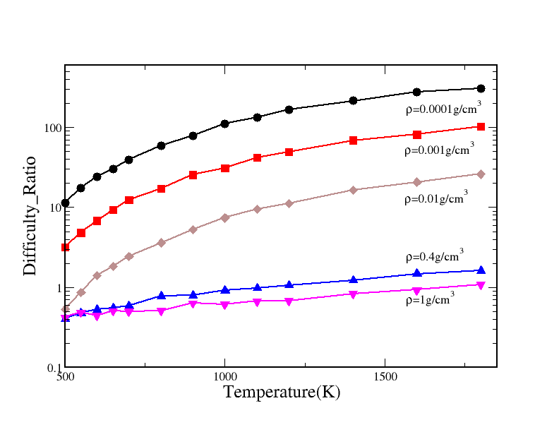
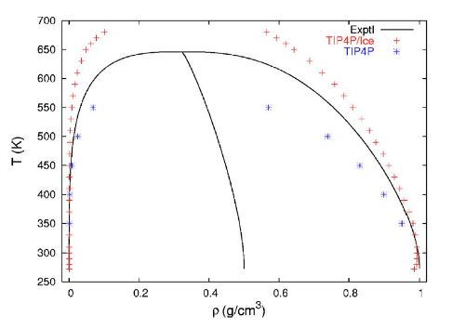
Results
Water Isocal

Slide 17
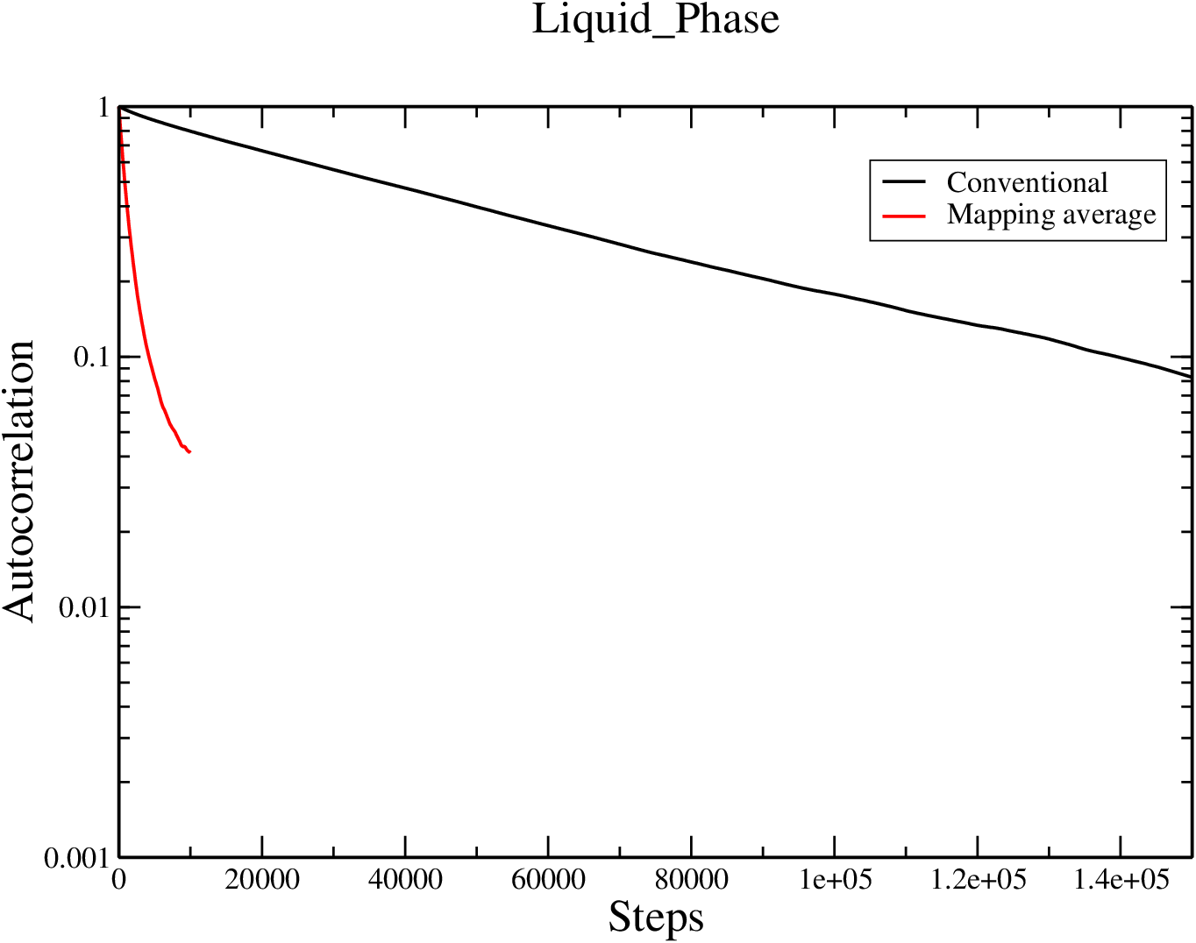
Results
Results Correlation liquid phase
Notes:
Liquid phase: Rho = 0.9
Gas phase: Rho = 0.001
T=650K

Slide 18
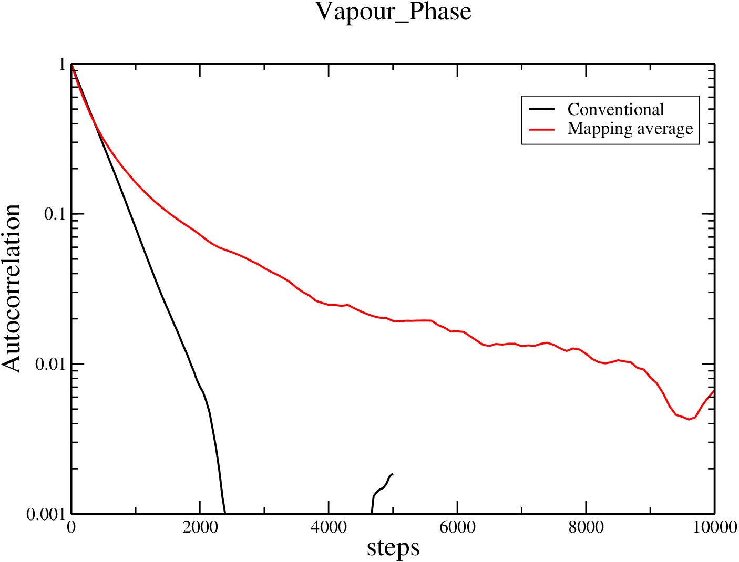
Results
Results correlation gas phase

Slide 19
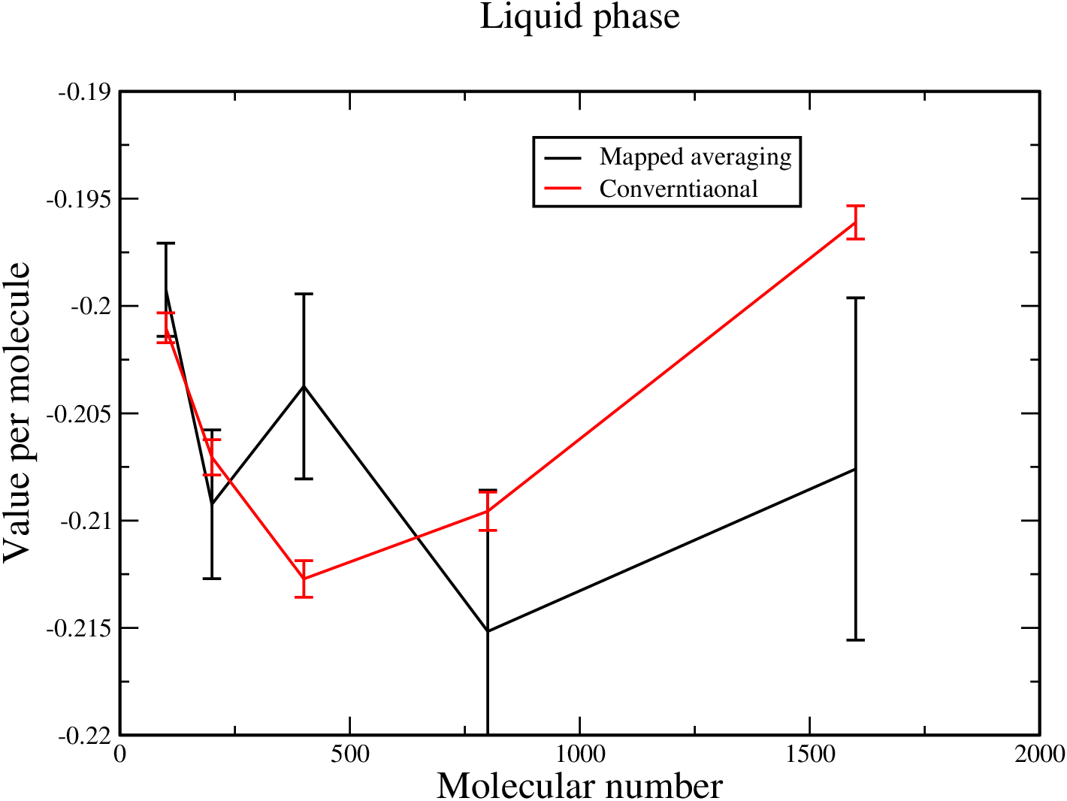
Results
Results SZ-liquid
Notes:
N=100

Slide 20
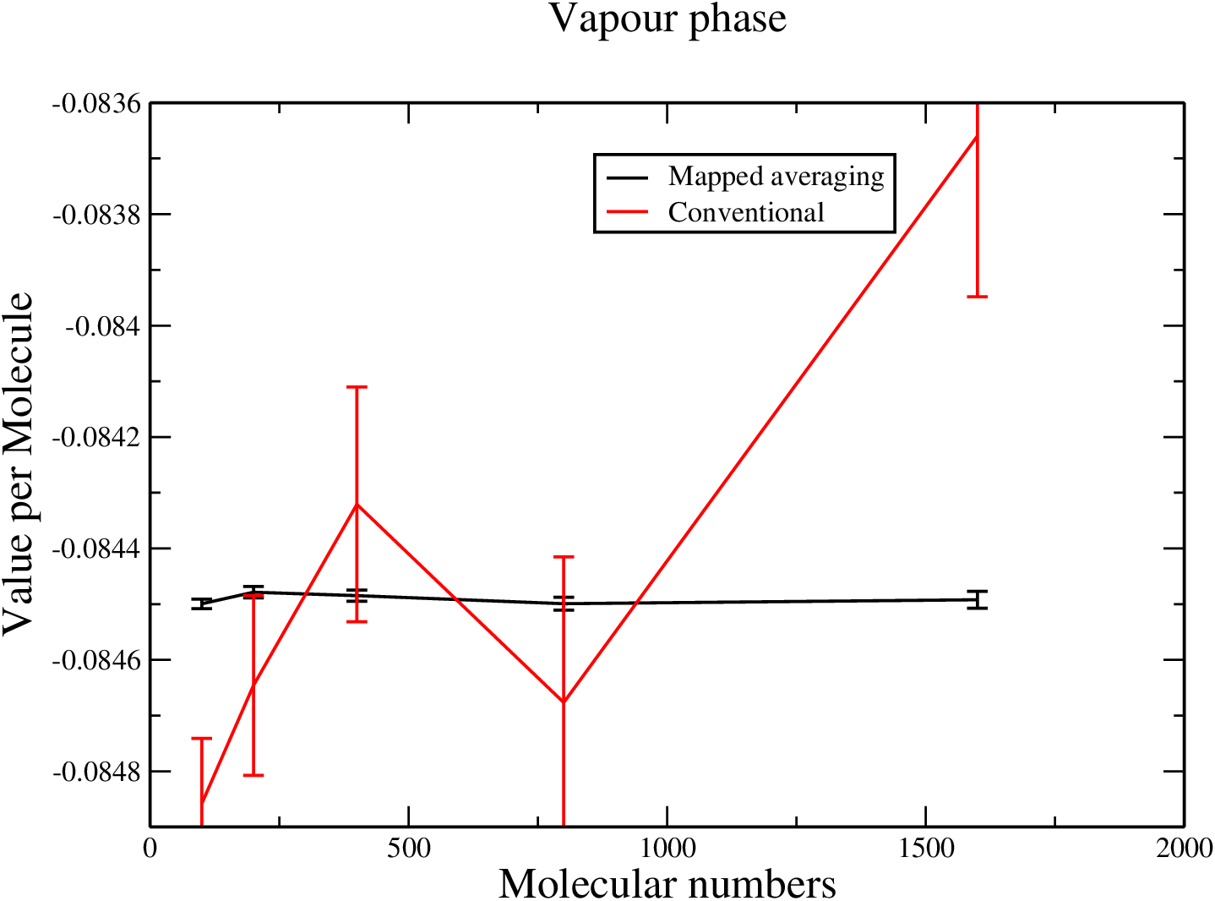
Results
Results SZ_gas_phase

Slide 21
Thanks!
PPT模板下载：www.1ppt.com/moban/ 行业PPT模板：www.1ppt.com/hangye/
节日PPT模板：www.1ppt.com/jieri/ PPT素材下载：www.1ppt.com/sucai/
PPT背景图片：www.1ppt.com/beijing/ PPT图表下载：www.1ppt.com/tubiao/
优秀PPT下载：www.1ppt.com/xiazai/ PPT教程： www.1ppt.com/powerpoint/
Word教程： www.1ppt.com/word/ Excel教程：www.1ppt.com/excel/
资料下载：www.1ppt.com/ziliao/ PPT课件下载：www.1ppt.com/kejian/
范文下载：www.1ppt.com/fanwen/ 试卷下载：www.1ppt.com/shiti/
教案下载：www.1ppt.com/jiaoan/

